Slide 1

Data Science Applications
Exploring real-world uses in Healthcare, Finance, and Retail.

Slide 2

Introduction
In this presentation, we'll explore how data science is transforming various industries. From healthcare innovations to finance strategies and retail insights, data science is making a significant impact.

Slide 3

01
Healthcare

Slide 4

Predictive analytics for patient outcomes
Predictive analytics uses historical data and machine learning algorithms to forecast patient outcomes. For example, it helps in predicting which patients are at risk for certain conditions, allowing for early interventions and personalized treatment plans.

Slide 5

Personalized medicine and genomics
Personalized medicine tailors treatment to individual patients based on genetic information. By analyzing genomic data, healthcare providers can identify the most effective therapies for patients, enhancing treatment success and minimizing side effects.

Slide 6

Operational Efficiency Through Data Management
Data management tools help healthcare organizations streamline operations. By analyzing data on patient flow, resource utilization, and care processes, hospitals can reduce wait times, optimize staff allocation, and improve overall patient care.

Slide 7

02
Finance

Slide 8

Risk Assessment Algorithms
Risk assessment algorithms utilize statistical models to evaluate the likelihood of potential losses in finance. By analyzing past data and market trends, financial institutions can gauge which investments pose higher risks and adjust their strategies accordingly.

Slide 9
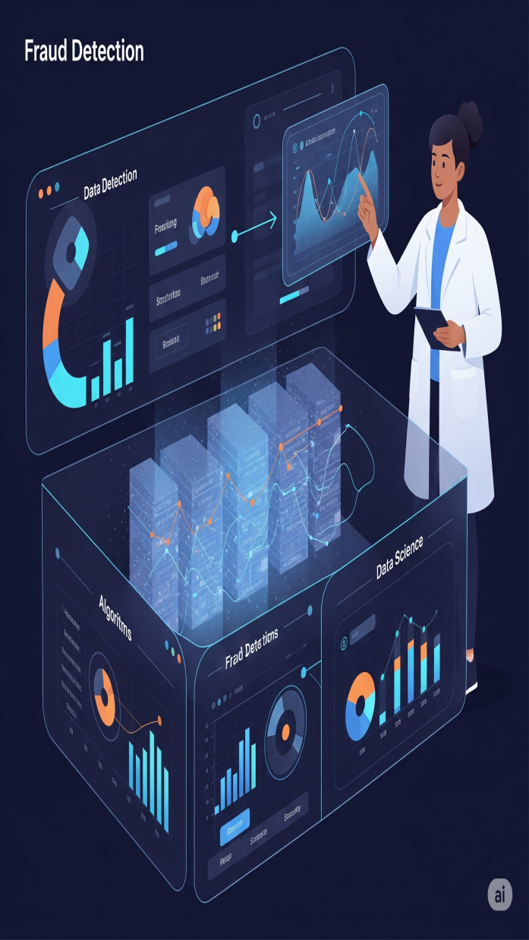
Fraud Detection Techniques
Fraud detection techniques employ machine learning and data analytics to identify unusual patterns in transactions. By continuously monitoring financial activities, these systems can detect fraudulent behavior in real-time, helping companies reduce losses.

Slide 10

Algorithmic Trading Strategies
Algorithmic trading uses mathematical models and algorithms to execute trades at optimal times. These strategies analyze market data at lightning speed, helping traders capitalize on small price fluctuations and improve profitability.

Slide 11
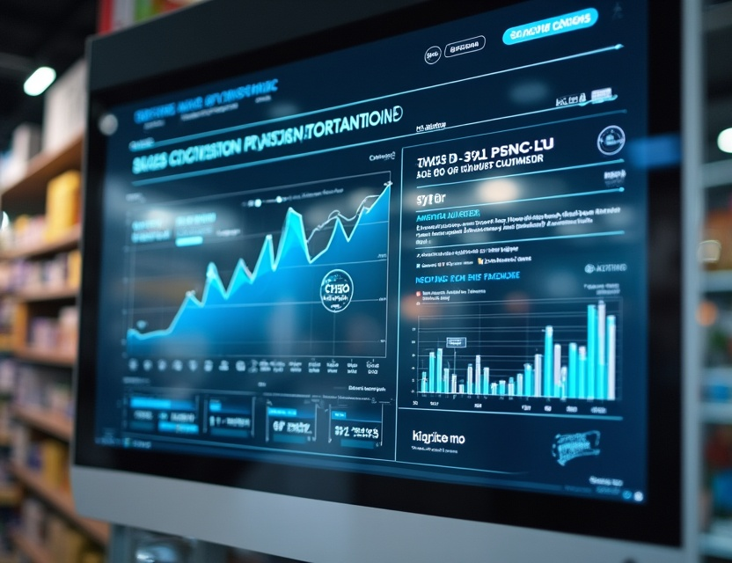
03
Retail

Slide 12
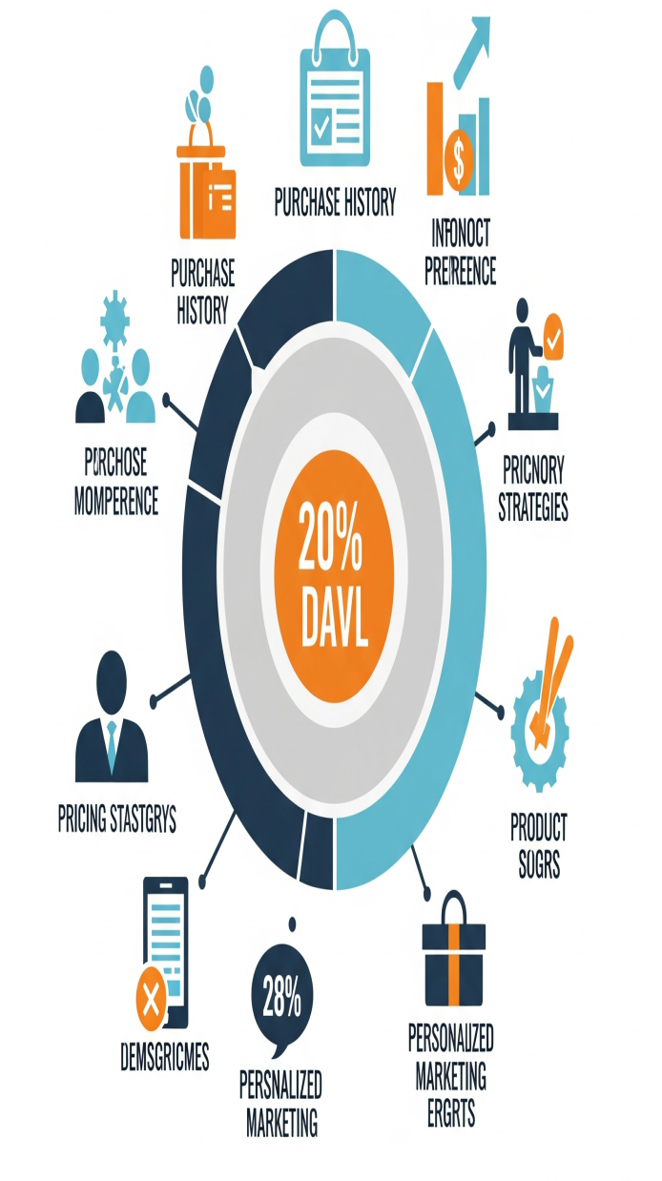
Customer Behavior Analysis
Customer behavior analysis involves studying purchasing patterns and preferences to better understand buying habits. With this data, retailers can tailor their offerings, improve customer engagement, and enhance the shopping experience.

Slide 13

Inventory optimization with data insights
Data insights allow retailers to optimize inventory management by analyzing sales trends and customer demand. This leads to reduced stockouts and overstock situations, resulting in improved cash flow and customer satisfaction.

Slide 14
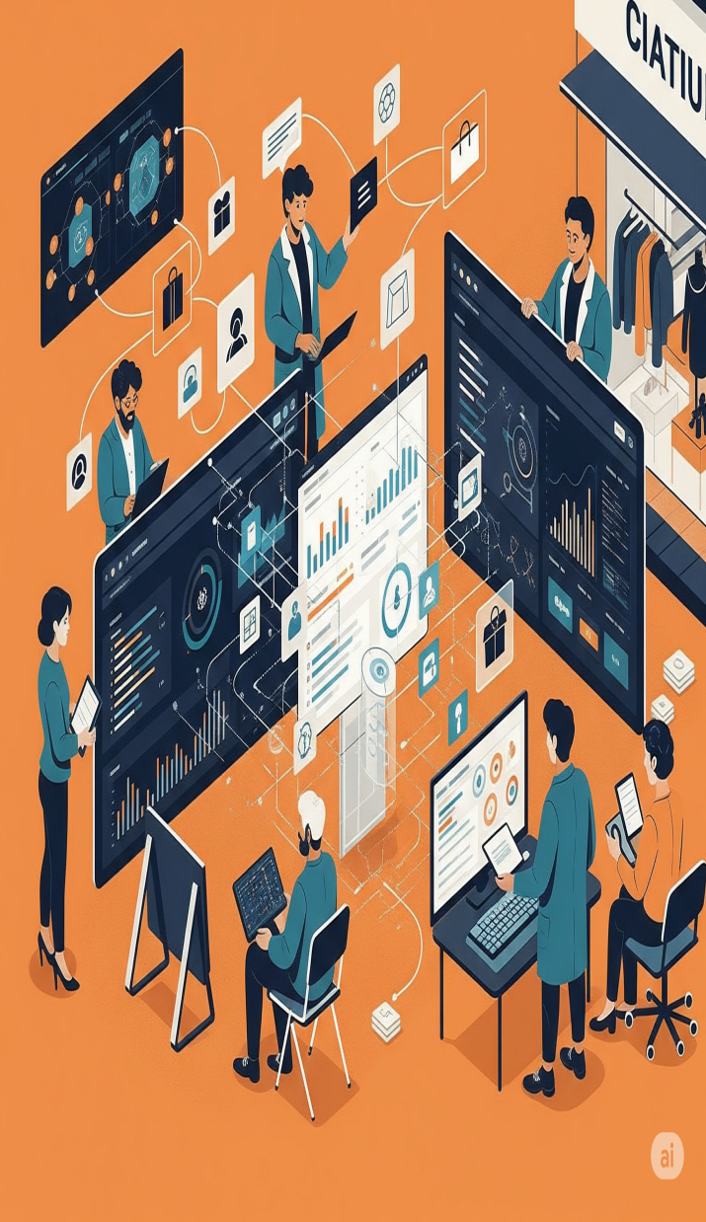
Personalized Marketing Strategies
Personalized marketing strategies leverage data to create targeted advertising campaigns. By understanding customer demographics and preferences, retailers can deliver customized promotions and recommendations, increasing conversion rates.

Slide 15
Conclusion
In summary, data science is revolutionizing industries like finance and retail by enhancing decision-making processes and improving overall efficiency. By harnessing the power of data, organizations can better serve their customers and drive growth.

Slide 16
Thank you!
Do you have any questions?
+00 000 000 000

